Slide 1

3x50MWp Solar Farms by Cares4Energy &
Savannah Energy
Electrification of The Gambia
(NAWEC)
CARES4Energy

Slide 2
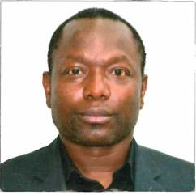
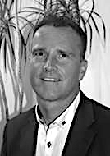
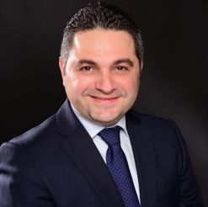
Executive Summary
Experienced Energy Professionals with strong networking in The Gambia
  Highly educated people each with over 20 years of work experience within the Energy and Infrastructure Power Industry
  Strong international relations and valuable networking in The Gambia
  Sound records in Strategic Leadership and Project Development, Management and Execution
  Development and Management of project in African countries, America, Canada, Asia, Australia and Europe
Team
Networking in The Gambia
Sheriff Sanno
    BSc and MSc in Electrical Power Engineering
    Over 22 years of experience in onshore / offshore Oil & Gas, Refinery, Petrochemical, LNG, and Power Generation Industries
    Originally from The Gambia and has subsequently worked globally
    Work experience covering Europe, Middle East, Asia and Africa
Robin Peters
    Over 30 years of experience of the energy sector including all renewables (On/Offshore Wind, Hydro/Tidal, Solar, Anaerobic Digestive Systems), nuclear and oil and gas.
    Managed mega-scale project in all energy sectors
    Experience covering Europe, North Africa, Middle East, Far East, North America
    Project Director with Electrical Engineering background
    Wassim Ayoubi
    25 Years of experience in solar and construction industry
    Experience covering Europe, Middle East and Far East with focus in Dubai, Germany, Qatar and Maldives
    Managing the commercial, contractual and procurement of solar and energy plant.
    Construction and Installation knowledge and implementation
CARES4Energy
* Parties who we have direct contact
Sheriff
Sanno
Wassim
Ayoubi
Robin
Peters
*Chief Prot. Officer to the President
*Minister of Enery and Petrolleum
In Country
Business Man
*PS Ministry of Energy &Petrolleum
*​ Gambian Ambassadot to Qatar
Chief of Staff of the Arm Offices
Adama Barrow
President of The Gambia

Slide 3
CARES 4 ENERGY
Cares4Energy is a now a UK registered company, previously it was registered in Denmark – In operation since 2018 (DK), closed 2019 and then registered in the UK Jun 2024.
Registered address for Cares4Energy: 22 FIRETHORN, Shinfield, Reading, RG2 9GD,
UK Company number 15779183 Link - https://find-and-update.company-information.service.gov.uk/company/15779183/officers
Managing Director – Sheriff Sanno
Employees
  Robin Peters - Chief Operations Officer (COO) – Based in the UK
  Manjang Cham – Country Manager – Based in the Gambia
Accountant:- Soteriou Christou
  Chartered Accountants
  6A Dickensions Place, London, SE25 5HL
  Tel: 020 8655 2252
  Email: panicos@soteriouchristou.com

Slide 4
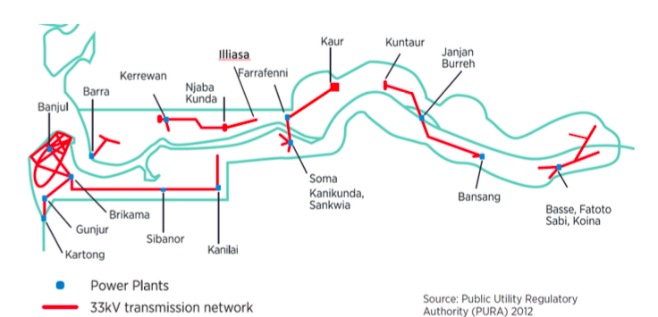
The Gambia Population Regions (A to F)* and Electricity Infrastructure with Installed Capacity (MW) & Proposed 50MW Solar Farm Locations
D
E
B
A​
C​
F
C
Proposed 50MW Solar Farm
A Population: 1,096,923 Installed capacity: 67,35 MW
B Population: 220,080 Installed capacity: 4.78 MW
C Population: 81,042 Installed capacity: 1.4 MW
F Population: 23,722, Installed capacity:2.6 MW
E Population: 125,204, Installed capacity:1.8 MW
D Population: 96,703 Installed capacity: 0.72 MW
* Figures taken from Central Statistics department of The Gambia based on 2013 data
Notes:
For the moment there is no better map available

Slide 5
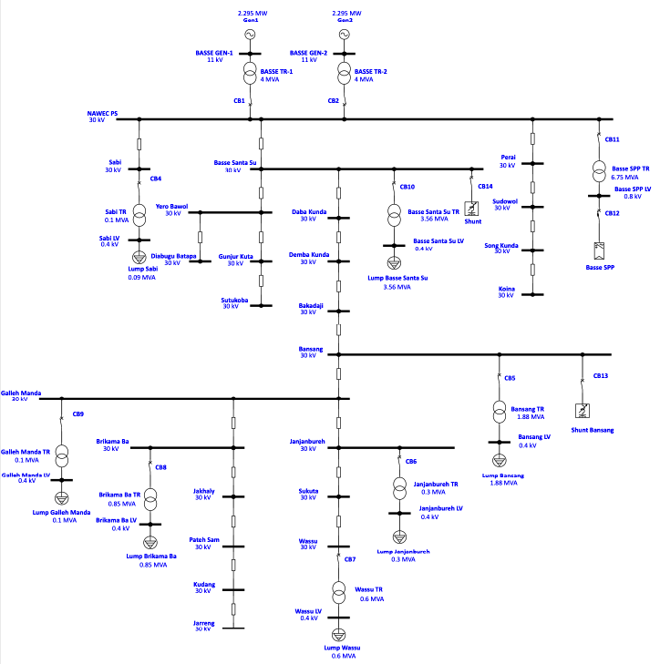
Single Line Diagram
Of BASSE Region
Solar Farm – 50MW BASSE
Connection -Most likely requires Switchgear/Transformer upgrade

Slide 6
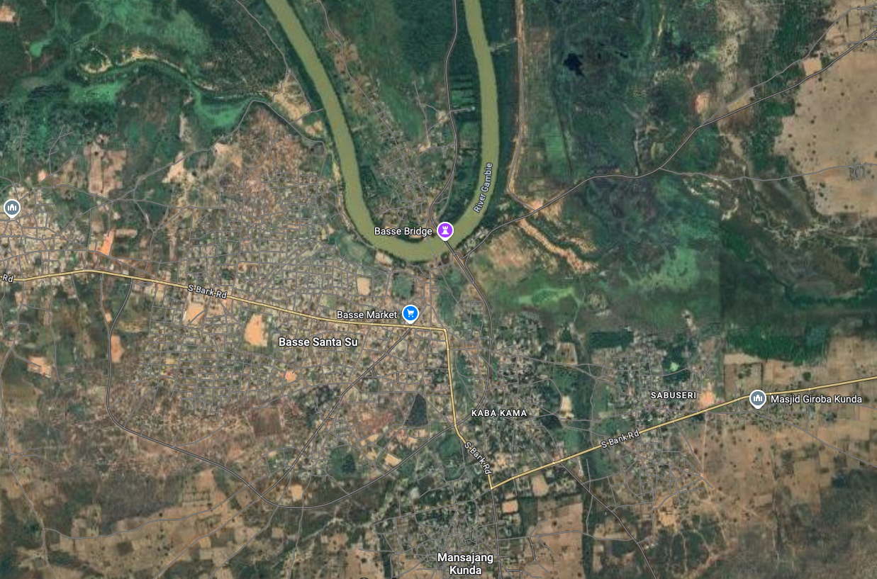
Solar Farm – Basse connection
Region for 50MW Solar Park
Risk Matrix for Basse
Risk ID | Risk Description | Category | Likelihood | Impact | Risk Rating | Mitigation Plan | Owner | Status
001 | Delays in permitting approvals | Legal | High | High | Critical | Work closely with local authorities; engage legal experts to expedite approvals | Project Manager | Open
002 | Supply chain disruptions | Financial | Medium | High | High | Diversify suppliers; maintain buffer inventory for critical components | Procurement Team | Open
003 | Poor site selection impacting efficiency | Technical | Medium | High | High | Conduct detailed feasibility and solar radiation studies; use GIS tools for analysis | Technical Lead | Open
004 | Adverse weather during construction | Environmental | Low | High | Medium | Schedule work during favorable seasons; develop contingency plans | Site Manager | Open
005 | Cost overruns due to unforeseen issues | Financial | Medium | High | High | Include a contingency budget; closely monitor expenses | Finance Team | Open
006 | Grid connection delays | Operational | Medium | High | High | Early engagement with utility companies; follow up regularly | Grid Connection Lead | Open
007 | Safety incidents on site | Health & Safety | Low | High | High | Enforce strict safety protocols; regular training and audits | Safety Officer | Open
008 | Non-compliance with environmental regulations | Environmental | Low | High | Medium | Conduct Environmental Impact Assessments (EIA); comply with regulations | Compliance Officer | Open
009 | Technology performance below expectations | Technical | Low | Medium | Medium | Select proven technologies; perform thorough pre-commissioning tests | Technical Lead | Open
010 | Stakeholder/community opposition | Stakeholder | Medium | Medium | Medium | Engage stakeholders early; conduct community outreach programs | Community Liaison | Open

Slide 7
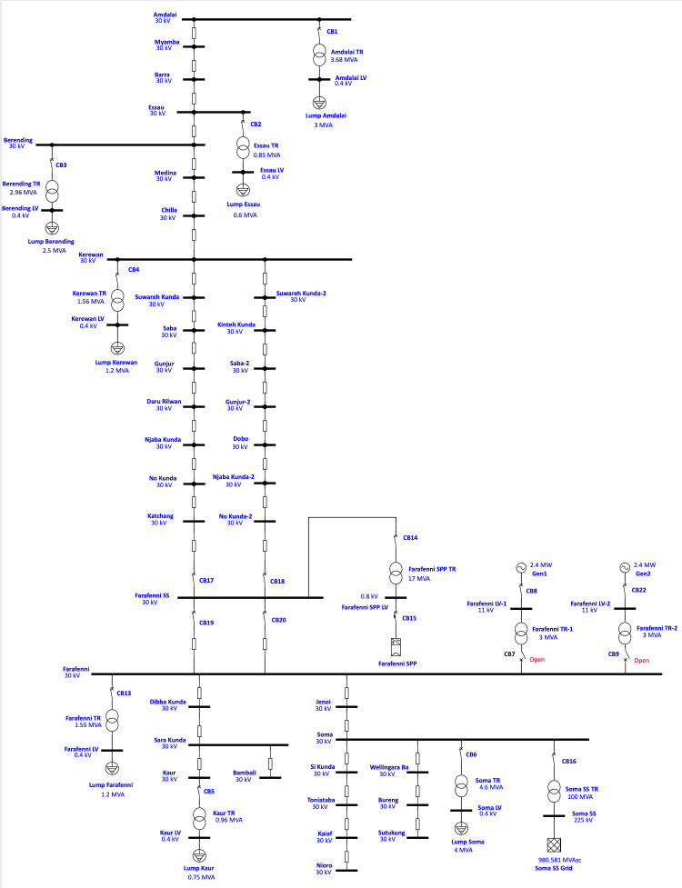
Amdalai – on border of Senegal & Gambia
Single Line Diagram
Of North Bank Region
Solar Farm – 50MW Kerewan connection
Most likely requires Switchgear/Transformer upgrade
Solar Farm – 50MW Farafenni
Connection - Most likely requires Switchgear/Transformer upgrade

Slide 8
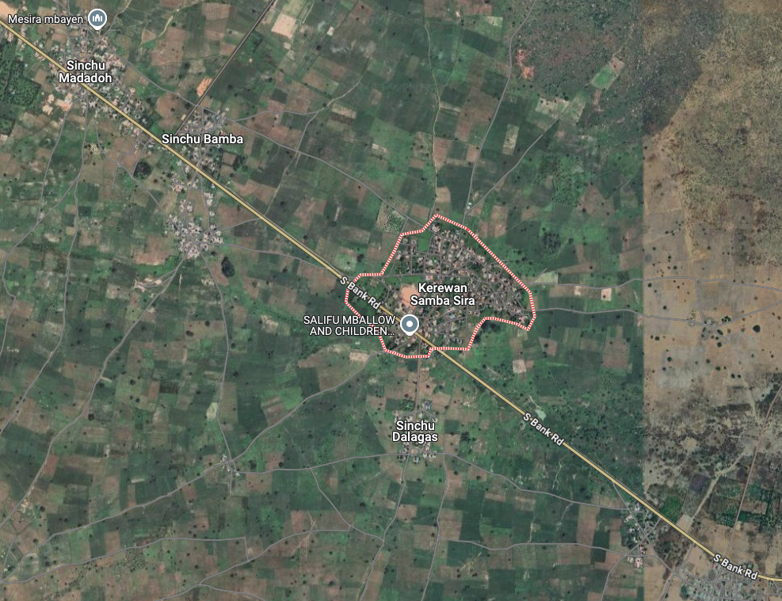
Solar Farm – Kerewan connection
Region for 50MW Solar Park
Risk Matrix for Kerewan
Risk ID | Risk Description | Category | Likelihood | Impact | Risk Rating | Mitigation Plan | Owner | Status
001 | Delays in permitting approvals | Legal | High | High | Critical | Work closely with local authorities; engage legal experts to expedite approvals | Project Manager | Open
002 | Supply chain disruptions | Financial | Medium | High | High | Diversify suppliers; maintain buffer inventory for critical components | Procurement Team | Open
003 | Poor site selection impacting efficiency | Technical | Medium | High | High | Conduct detailed feasibility and solar radiation studies; use GIS tools for analysis | Technical Lead | Open
004 | Adverse weather during construction | Environmental | Low | High | Medium | Schedule work during favorable seasons; develop contingency plans | Site Manager | Open
005 | Cost overruns due to unforeseen issues | Financial | Medium | High | High | Include a contingency budget; closely monitor expenses | Finance Team | Open
006 | Grid connection delays | Operational | Medium | High | High | Early engagement with utility companies; follow up regularly | Grid Connection Lead | Open
007 | Safety incidents on site | Health & Safety | Low | High | High | Enforce strict safety protocols; regular training and audits | Safety Officer | Open
008 | Non-compliance with environmental regulations | Environmental | Low | High | Medium | Conduct Environmental Impact Assessments (EIA); comply with regulations | Compliance Officer | Open
009 | Technology performance below expectations | Technical | Low | Medium | Medium | Select proven technologies; perform thorough pre-commissioning tests | Technical Lead | Open
010 | Stakeholder/community opposition | Stakeholder | Medium | Medium | Medium | Engage stakeholders early; conduct community outreach programs | Community Liaison | Open

Slide 9
Solar Farm – Farafenni connection
Region for 50MW Solar Park
Risk Matrix for Farafenni
Risk ID | Risk Description | Category | Likelihood | Impact | Risk Rating | Mitigation Plan | Owner | Status
001 | Delays in permitting approvals | Legal | High | High | Critical | Work closely with local authorities; engage legal experts to expedite approvals | Project Manager | Open
002 | Supply chain disruptions | Financial | Medium | High | High | Diversify suppliers; maintain buffer inventory for critical components | Procurement Team | Open
003 | Poor site selection impacting efficiency | Technical | Medium | High | High | Conduct detailed feasibility and solar radiation studies; use GIS tools for analysis | Technical Lead | Open
004 | Adverse weather during construction | Environmental | Low | High | Medium | Schedule work during favorable seasons; develop contingency plans | Site Manager | Open
005 | Cost overruns due to unforeseen issues | Financial | Medium | High | High | Include a contingency budget; closely monitor expenses | Finance Team | Open
006 | Grid connection delays | Operational | Medium | High | High | Early engagement with utility companies; follow up regularly | Grid Connection Lead | Open
007 | Safety incidents on site | Health & Safety | Low | High | High | Enforce strict safety protocols; regular training and audits | Safety Officer | Open
008 | Non-compliance with environmental regulations | Environmental | Low | High | Medium | Conduct Environmental Impact Assessments (EIA); comply with regulations | Compliance Officer | Open
009 | Technology performance below expectations | Technical | Low | Medium | Medium | Select proven technologies; perform thorough pre-commissioning tests | Technical Lead | Open
010 | Stakeholder/community opposition | Stakeholder | Medium | Medium | Medium | Engage stakeholders early; conduct community outreach programs | Community Liaison | Open

Slide 10
Responsibility Matrix: 50 MW Solar Farm Project
Task/Deliverable | C4E Developer | NAWEC Electricity Authority | Notes
Site Selection and Acquisition | A, R | I | Developer leads the process; EA informed.
Feasibility Study | A, R | C | Developer conducts studies; EA consulted.
Permitting and Approvals | A, R | C | Developer leads; EA provides guidance.
Grid Connection Agreement | C | A, R | EA responsible for grid connection approval.
System Design and Engineering | A, R | C | Developer ensures design meets EA standards.
Environmental Impact Assessment | A, R | C | Developer responsible; EA reviews and consults.
Financing and Budgeting | A, R | I | Developer manages funding; EA informed.
Procurement of Equipment | A, R | I | Developer handles procurement; EA informed.
Construction Planning | A, R | I | Developer plans; EA informed.
Grid Infrastructure Upgrades | I | A, R | EA responsible for grid upgrades, if needed.
Installation and Construction | A, R | C | Developer oversees; EA consulted for compliance.
Inspection and Testing | C | A, R | EA leads testing; Developer assists and ensures compliance.
Commissioning and Handover | A, R | C | Developer responsible; EA provides final approval.
Operation and Maintenance | A, R | I | Developer manages O&M; EA informed of performance.
Monitoring and Reporting | A, R | I | Developer ensures regular reporting to EA.
Decommissioning (End of Life) | A, R | C | Developer leads; EA consulted for grid concerns.
Key : R - Responsible, A - Accountable, C - Consulted, and I - Informed

Slide 11
Outline Proposal for Power Purchase Agreement (PPA) for a 50MW Solar Farm
This proposal outlines the terms and conditions for a Power Purchase Agreement (PPA) between [Developer Name] ("Seller") and [Offtaker/Utility Name] ("Buyer") for the purchase of electricity generated by a 50 MW solar farm, [Project Name], located at [Location].
1. Parties Involved
Seller: [Developer Name]
  Responsible for developing, constructing, and operating the solar farm.
Buyer: [Offtaker/Utility Name]
  Committed to purchasing electricity generated by the solar farm under agreed terms.
  2. Project Details
Project Capacity: 50 MW (AC)
Location: [Project Address or Coordinates]
Technology Used: Photovoltaic solar panels with inverters and tracking systems for enhanced efficiency.
3. Contract Term
Term Duration: 20-25 years from the Commercial Operation Date (COD).
Start Date: [Expected COD Date].
Renewal Option: Upon mutual agreement.
4. Energy Pricing
Tariff Structure:
  Fixed rate of [$/kWh] for the contract term.
  Annual escalation of [X%] to account for inflation.
Time of Use (TOU) Tariff:
  Peak Hours: [$/kWh]
  Off-Peak Hours: [$/kWh]
Currency: Payments denominated in [Local Currency/US Dollars].
5. Delivery Point
Point of Interconnection (POI): [Grid Substation or Connection Point]
All electricity generated will be delivered to the grid at the POI.
6. Payment Terms
Billing Cycle: Monthly based on metered energy delivered.
Payment Due Date: Within [X] days of invoice receipt.
Late Payment Penalty: [X%] of overdue amount per month.
7. Performance Guarantees
Guaranteed Energy Output: The solar farm will deliver [X GWh/year] with a performance deviation allowance of [±X%].
Underperformance Penalty: Seller to compensate Buyer if output falls below guaranteed levels due to operational inefficiencies.
8. Force Majeure
Neither party will be liable for non-performance due to force majeure events, including natural disasters, legal changes, or unforeseen circumstances beyond their control.
9. Environmental Attributes
Seller retains ownership of all renewable energy certificates (RECs) unless otherwise agreed.
Buyer may negotiate for purchase or transfer of RECs.
10. Regulatory Compliance
Both parties will comply with all local and national regulations governing electricity generation and distribution.
11. Termination Clause
Either party may terminate the agreement upon:
  Breach of contract terms.
  Failure to meet financial or operational milestones.
  Mutual agreement.
12. Dispute Resolution
Mechanism: Negotiation, mediation, or arbitration.
Jurisdiction: [Specify Governing Law and Jurisdiction].

Slide 12
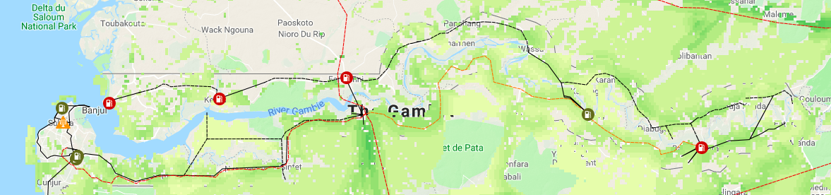
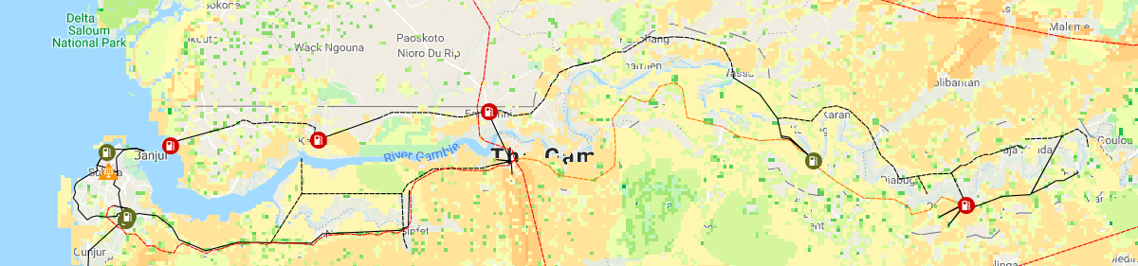
Electricity Infrastructure with PV suitability
Suitable areas for grid connected PV
Suitable areas for off-grid PV
Moderately
suitable
Best suitable
Suitable
Less suitable
* Map source ECOWAS.org

